Slide 1
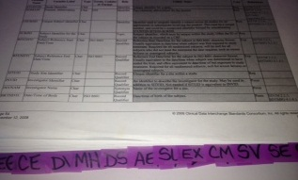

Notes to Instructor
Material Needed
Hard copies of the SDTM IG V3.2 with labelled Post-It notes attached to each domain
Each participant will need to bring their laptop to access workshop templates needed to complete workshop exercises
Excel file Exercise Templates and additional electronic resources on the External SharePoint site

Slide 2
Electronic Documents Required
Lilly Workshop Mod4.pptx (this power point)
Participants will need the following for exercises:
Lilly Mod 4 Exercise.xlsx
CRFs.pdf
For Reference:
SDTM IG V3.2
NCI Controlled Terminology.xls
ct_vl_global_library.xls

Slide 3
Lilly Workshop Module 4 SDTM Special Purpose Domains
Notes:
Intro: If this module is the first module of the day/Wave, introduce self, facilitators, and go around the room for introductions:
Introduce what will be covered in Wave 2 in terms of classes, as well as subtopics: Special Purpose Domains and CT (mod 4), Findings (mod 5), Interventions (mod 6)

Slide 4
Objectives
Encourage participation to enhance learning in this hands-on workshop
Provide an overview of Special Purpose Domains
Provide an introduction to Controlled Terminology to enable participants to complete exercises
Participants will be able to provide CT for Special Purpose variables based on Lilly’s Global Library
Participants will be able to create a DM domain based on raw data and DM Standards

Slide 5
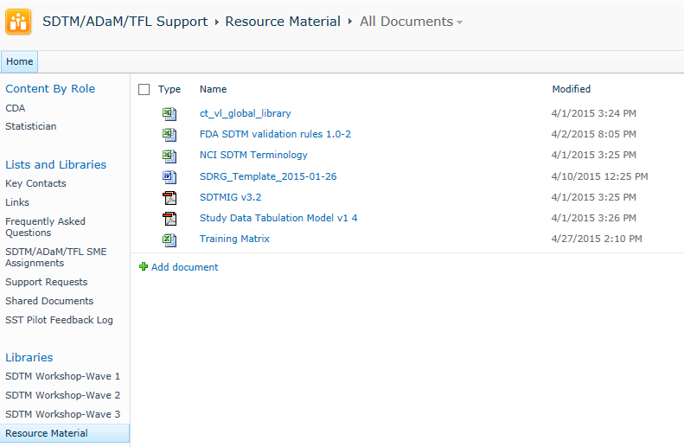
Before We Get Started………
Open the Lilly Global Library
Notes:
This is in preparation for the exercises. This file will be used in the exercises for this module, and is large so it can take a while to open.

Slide 6
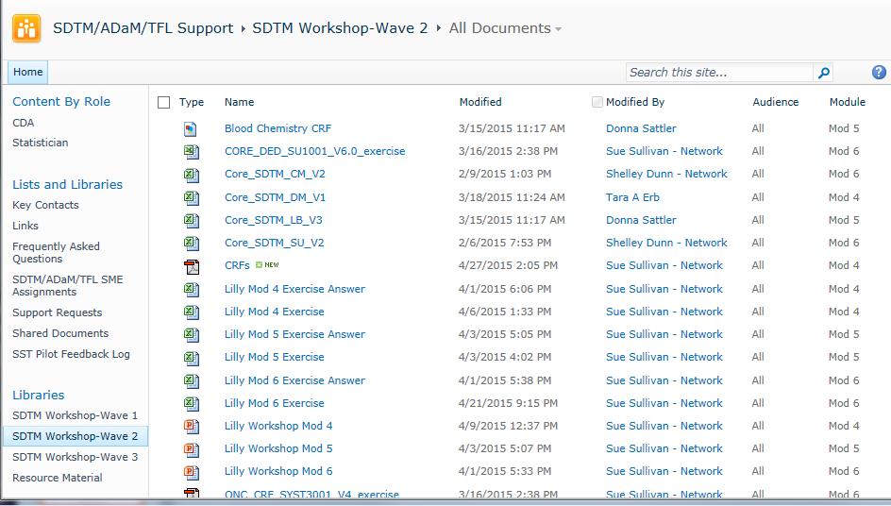
Before We Get Started………
Navigating the Collaboration Site
Click on Module to filter
Click on library to filter
Notes:
Show students where Wave 2 documents reside and the ability to filter on Library and Module

Slide 7
Introduction to Controlled Terminology

Slide 8

Introduction to Controlled Terminology
Similar to AE MedDRA coding and/or CM WHO Drug coding for consistency and ability to analyze like terms
SDTM has additional variables that require Controlled Terminology (CT)
National Cancer Institute website contains CDISC CT: http://www.cancer.gov/cancertopics/cancerlibrary/terminologyresources/cdisc NOTE: CDISC SDTM CT has been saved to the External Site as “NCI Controlled Terminology.xls” for this training
Additional CT may be sponsored defined
Notes:
Lilly has CT- sponsor defined, for both SDTM and ADaM. CDISC CT for ADaM is sparse.

Slide 9
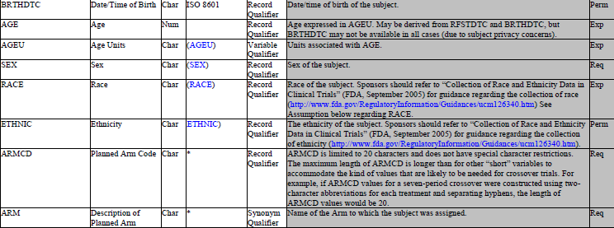
CT Column in SDTM IG
Open SDTM IG to DM
Check Controlled Terms, Codelist or Format column in SDTM IG
Notes:
This is a snapshot of the IG for the purpose of looking at the different types of CT

Slide 10
SDTM IG CT/Format Options
Controlled Terms, Codelist or Format | Example | Extensible | What this means
A value, no parentheses | DM | N/A | Value of DOMAIN = “DM”
A format, no parentheses | ISO 8601 | N/A | Date/time or duration format (e.g., 1985-03-31T08:15)
A value, in parenthesis | (NY) | No | NCI codelist: Only possible values are “N” or “Y”
A value, in parenthesis | (LBTESTCD) | Yes | NCI codelist can be extended to include sponsor-defined terms
An asterisk | * | N/A | Indicated variables may be subject to CT in the future, and/or CDISC expects sponsors may have their own CT.
Notes:
Review each item for each type of CT.

Slide 11
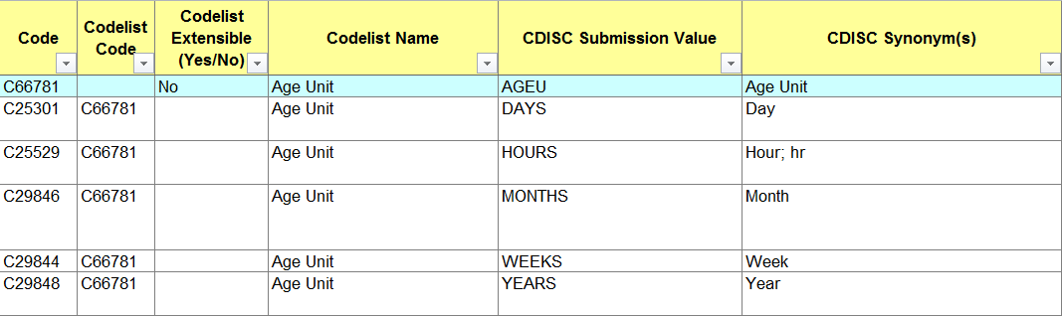
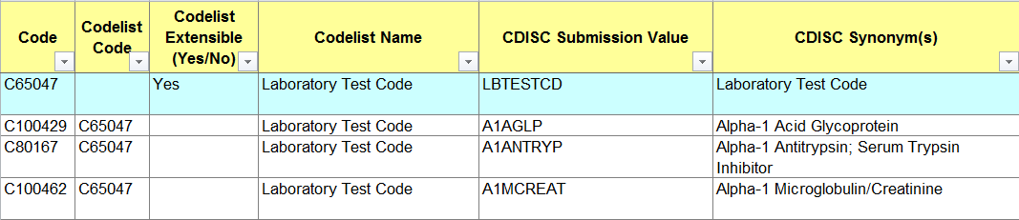
NCI Codelist Extensible Examples
Open NCI SDTM Terminology.xls and find codelists below

Slide 12
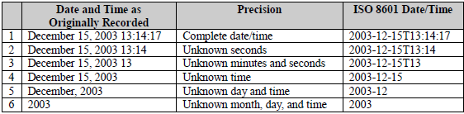
ISO 8601 as Date/Time
ISO8601 – date, date/time, or duration
YYYY-MM-DDThh:mm:ss
Y = Year, M = Month, D = Day, T = Use if representing a date & time, h = hour, m= minute, and s = second
Notes:
For stats; mention that ISO8601 also houses durations P4W = duration of 4 weeks

Slide 13

How to Apply CT
Review CRF
Map CRF terminology to CT as needed (e.g., if CRF collects RACE = “CAUCASIAN” this MUST be changed to RACE = “WHITE” in SDTM data set
DEDs contain codelists
Consult NCI Controlled Terminology, as appropriate
Refer to Internal Standards or Study Spec for CT naming conventions
Look up CT in Internal Global Library
ODM: DED is the source
SDTM: sdtm_ct_vl (Document Library)
ADaM: adam_ct_vl (Document Library)
ct_vl_global_library (Standards Development)
Notes:
Global library combines all 3 sources: ODM, SDTM, ADAM
Have students open the global library to show the different sources.
This can be done more in depth with Stats

Slide 14
Lilly Module 4 Exercise #1

Slide 15
Lilly Mod 4 Exercise #1
Use mock partial CRFs below
#1 #2 #3
In each of the above examples, determine the Lilly controlled terminology for each CRF
Demographics
Sex:
__ Male
Demographics
Sex:
__ Male
__ Female
__ Unknown
Demographics
Race:
__ Black
__ White
__ Asian
Notes:
Advance to next slide and get them started.
Note: Remove Unknown as this is not in Lilly CT/VL and this is not a Lilly CRF.???

Slide 16
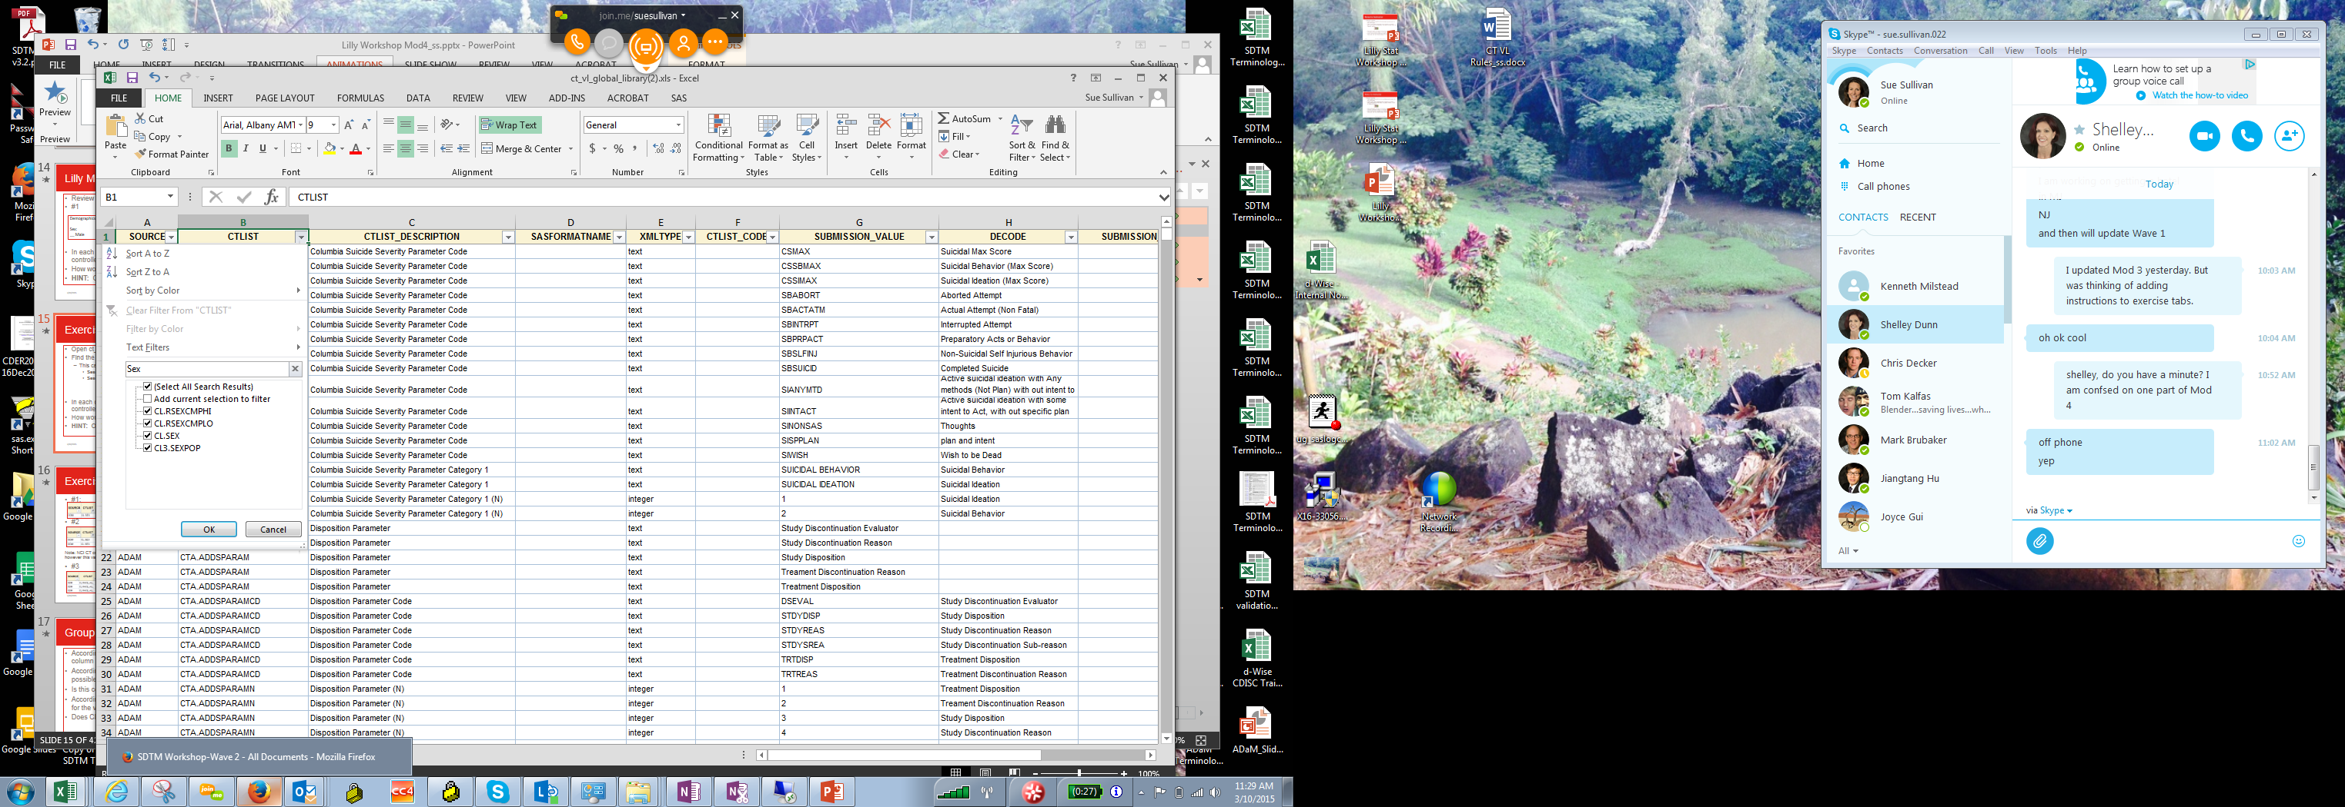
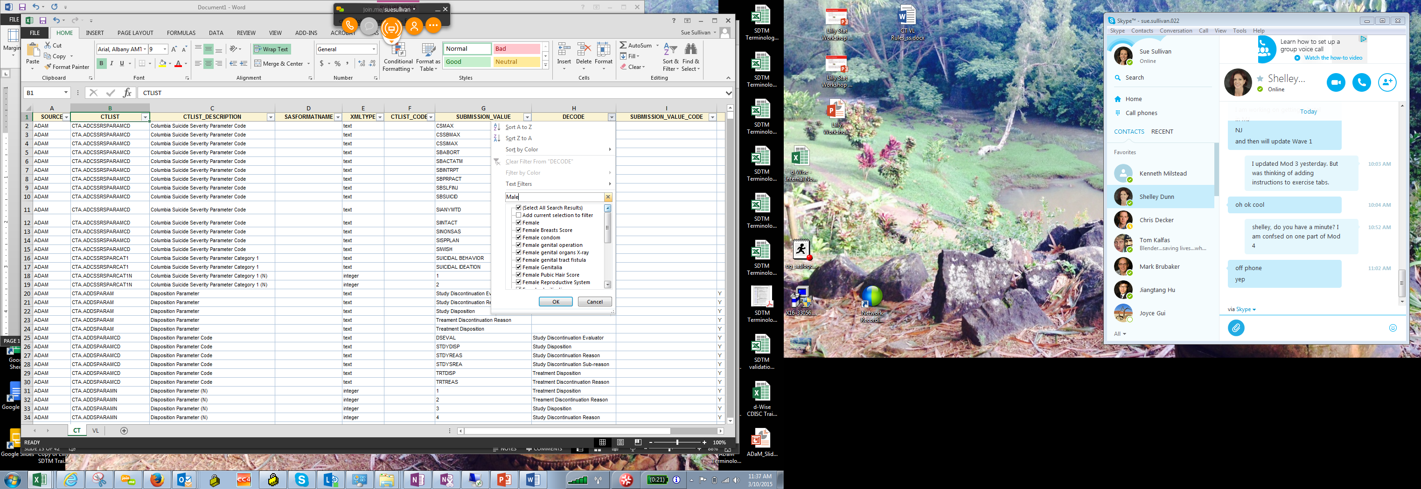
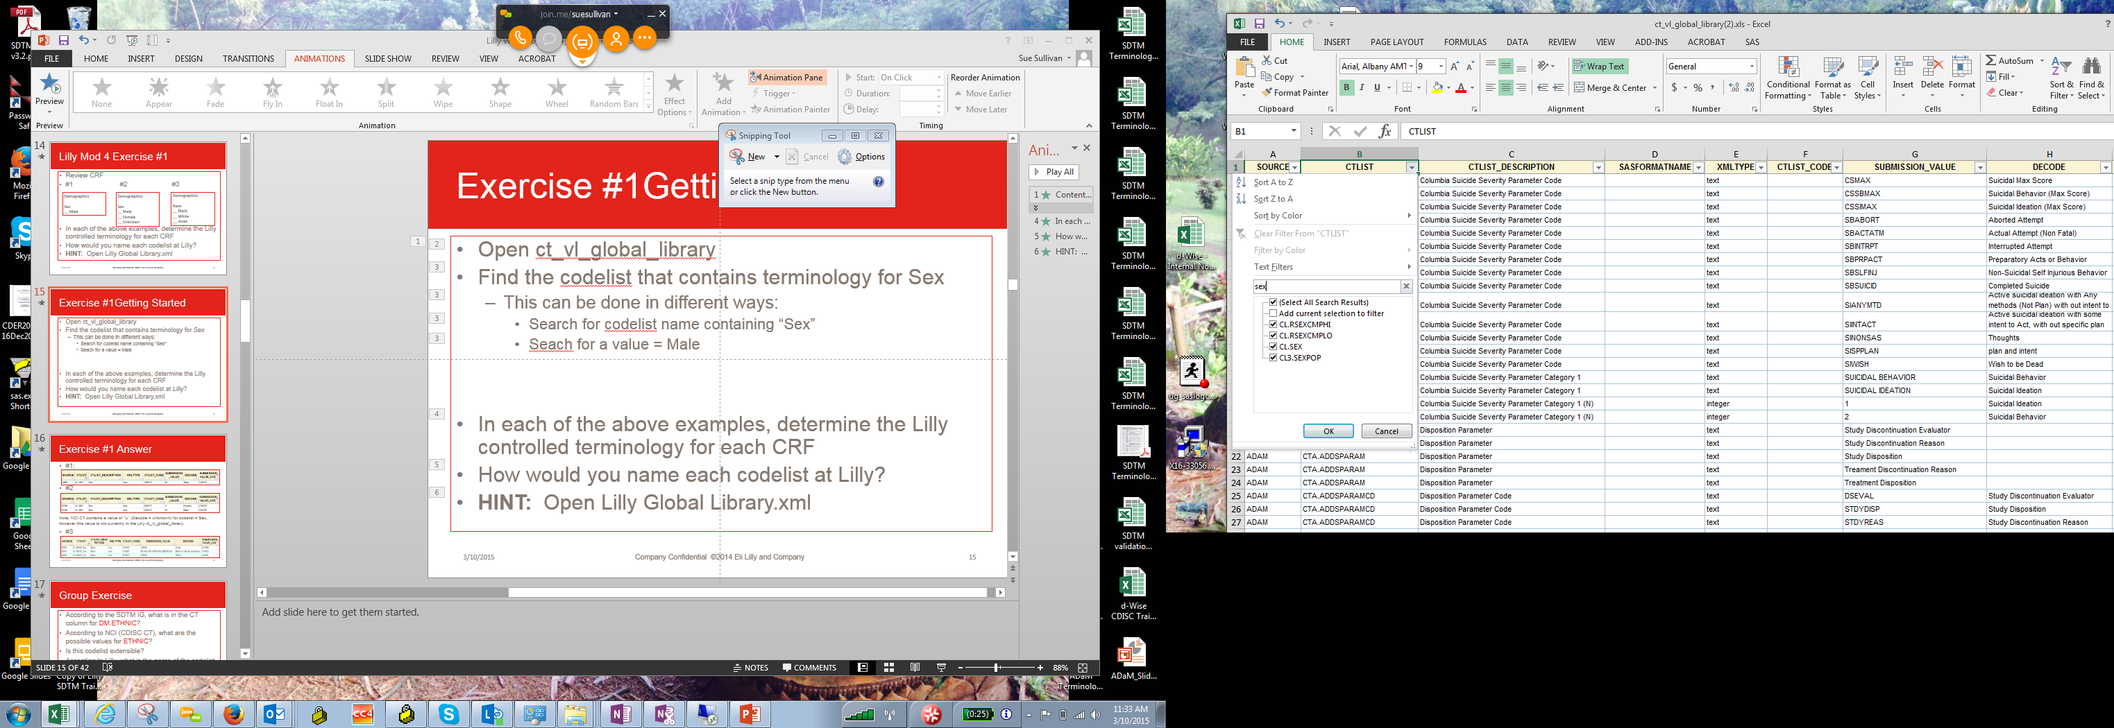
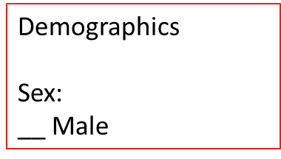
Exercise #1 Getting Started
1. Open ct_vl_global_library
2. Open the Mod 4 Exercise spreadsheet, Ex. 1 tab
3. Example CRF #1:
Find the codelist that contains terminology for Sex = Male
Search for codelist name containing “Sex”
or
Search for a value = Male
ct_vl_global_library.xls
4. Copy the row(s) of CT used for the CRF into the exercise spreadsheet
Notes:
Walk students through searching the ct_vl for values if needed. Use hyperlink to open the file and demonstrated different ways of searching excel. Advance to next slide and leave up for class to reference CRFs

Slide 17
Lilly Mod 4 Exercise #1
Use mock partial CRFs below
#1 #2 #3
In each of the above examples, determine the Lilly controlled terminology for each CRF
Demographics
Sex:
__ Male
Demographics
Sex:
__ Male
__ Female
__ Unknown
Demographics
Race:
__ Black
__ White
__ Asian
Notes:
The next slide contains the answers. Keep this slide up while class is working on the exercise.
Mention that these are not Lilly CRFs, so they may find issues w/ applying Lilly CT to non-Lilly CRFs; Lilly does not have a CT value for “unknown’. This is explained in the next slide.

Slide 18
Exercise #1 Answer
#1
#2
Note: CRF contains a value of Unknown, however this value is not currently in the Lilly ct_vl_global_library. (NCI SDTM CT does contain a value of U = Unknown)
#3
Notes:
28Apr2015: Lilly currently has an issue where there are 2 different codelists for race. (CL.RACE and CL.RACE_ALL, both ODM). CL.RACE_ALL is in DM1001 DED and in SDTM_DM_Core standard. Per documentation, CL.RACE is a new codelist as of 15JAN2015 and has been created in preparation for migration to the MDR. It is not used as a codelist by study teams.

Slide 19
Group Exercise
According to the SDTM IG, what is in the CT column for DM.ETHNIC?
Notes:
Lead the group and go through the exercise question by question.
Open the SDTM CT (NCI), find the codelsit for ETHNIC….what columns could you search on?

Slide 20
Group Exercise Answers
(ETHNIC)
NCI or CDISC CT
No
Lilly CL.ETHNIC
Do these match?

Slide 21
Group Exercise
According to the SDTM IG, what is in the CT column for DM.ETHNIC?
According to NCI (CDISC CT), what are the possible values for ETHNIC?

Slide 22
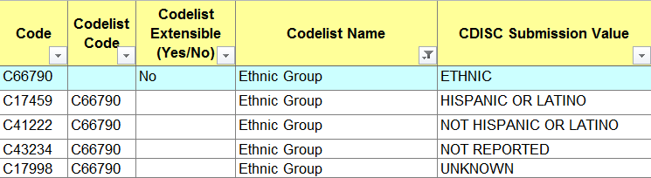
Group Exercise Answers
(ETHNIC)
NCI or CDISC CT
No
Lilly CL.ETHNIC
Do these match?

Slide 23
Group Exercise
According to the SDTM IG, what is in the CT column for DM.ETHNIC?
According to NCI (CDISC CT), what are the possible values for ETHNIC?
Is this codelist extensible?

Slide 24
Group Exercise Answers
(ETHNIC)
NCI or CDISC CT
No
Lilly CL.ETHNIC
Do these match?

Slide 25
Group Exercise
According to the SDTM IG, what is in the CT column for DM.ETHNIC?
According to NCI (CDISC CT), what are the possible values for ETHNIC?
Is this codelist extensible?
According to Lilly (ct_vl_global_libarary), what is the name of the codelist for the values of ETHNIC?

Slide 26
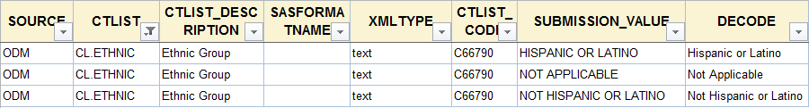
Group Exercise Answers
(ETHNIC)
NCI or CDISC CT
No
Lilly CL.ETHNIC
Do these match?
Notes:
4/28/15: there was discussion in class (April 2015) indicating that the Lilly value NOT APPICABLE was being updated, however this has not yet been done.
9/7/16: NOT REPORTED has since been added to the Lilly library, and NOT APPLICABLE is still there.

Slide 27
Special Purpose Domains

Slide 28

Class: Special Purpose
Special purpose domains are domains that do not conform to one of the three general observation classes (Interventions, Events, Findings)
CO
Demographics
Subject Elements
Subject Visits
SE
SV
Comments
DM

Slide 29
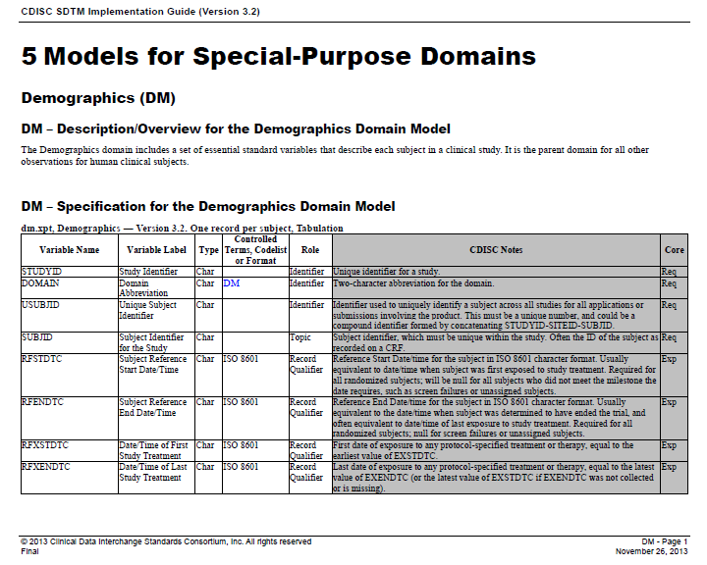
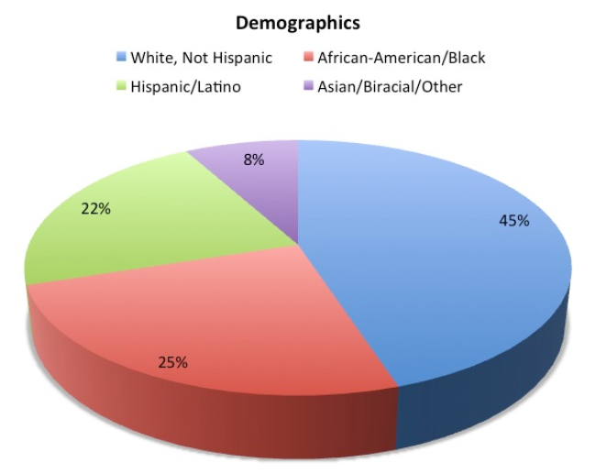
Demographics (DM) SDTM IG
Open the SDTM IG and let’s review the variables within the DM domain
Notes:
Intro to DM, metadata : variable name, label etc.

Slide 30

Where to Find DM Variables?
What variables are Required? Expected? Permissible?
Most data for the DM domain is collected on a
demographics CRF, but not all
Reference Start Date (RFSTDTC) and Reference End Date (RFENDTC), if populated, will require a date/time often from another CRF
Others: Date of first dose, date of last dose, date ended trial, etc. some variables are defined by the sponsor: RFSTDTC, RFENDTC
Notes:
Have students look at IG and go over question 1. group participation

Slide 31
Not All DM Variables May Be On CRF
COUNTRY
May come from a different source than the CRF (e.g., Protocol)
DTHDTC
Death Date will most likely be on an End of Study (EOS) CRF page
AGEU
ARMCD/ARM
Arm and Arm Code may come from a different source than the CRF (e.g., randomization file)
Age Units, AGEU, is a qualifier for AGE and may not be collected data
Consider: Variables not on the CRF, do they have to be included in an SDTM domain if they are in the SDTM IG?

Slide 32
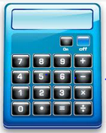
Derived DM Variables Examples
Variable AGE: Calculated based on SAP or per client
specified metadata
Date of Informed Consent -Birth Date
Study Day of Collection, DMDY: Calculated based on SAP or per client specified metadata
Date of Collection – Reference Start Date + 1
Subject Death Flag, DTHFL: Determined based on SAP or per client specified metadata
Set DTHFL=“Y” if death date is present. Otherwise, set DTHFL=“ ”
Notes:
DTHFL values are Y/null per the IG DM CDISC Notes

Slide 33

Comments (CO)
Comments may be collected on a single CRF page or on multiple CRF pages
How does a reviewer know the
source of the comments?
Notes:
RDOMAIN links to source, IDVAR and IDVARVAL are used to link to the exact record.
If ROMAIN is null, comment is caputured on a general comments CRF page.

Slide 34
Subject Elements (SE)
To understand SE domain, a general knowledge of the terms ELEMENT and EPOCH is required
There are “Trial Elements” and there are “Subject Elements”
ELEMENT is usually a description of each part of the trial. All of the Elements taken together cover the entire trial with no gaps between Elements
Note: In this example, subject took Drug A before Drug B
Screening
Rand.
Drug A
Wash-out
Drug B
Follow-up
Notes:
This and the next slides may be skipped if students have completed Mod 3 Trial Design Domains, unless they need a refresher.

Slide 35
Subject Elements (SE) Epoch
ARM: Planned treatment (e.g., Treatment, Drug A, etc.)
EPOCH: An interval of time associated with a study purpose
Screening
Randomization
Treatment
Follow-up
Screening
Rand.
1st Tx
2nd Tx
Follow-up

Slide 36
Subject Elements (SE) Epochs
ELEMENT & EPOCH example in a cross-over study (all subjects take Drug A and Drug B but not in the same order)
ELEMENT within an EPOCH can differ by subject
Subject #1
Subject #2
EPOCH
Screening
Rand.
Drug B
Drug A
Follow-up
Screening
Rand.
Drug A
Drug B
Follow-up
Screening
Rand.
1st Tx
2nd Tx
Follow-up

Slide 37
Example SE Domain
Element Code, ETCD, is required
Epoch, EPOCH, is permissible – although FDA has asked for this variable to be included for clinical subject-level observations
Planned Order of Elements within Arm, TAETORD, and ELEMENT are permissible
Notes:
Note: Subject 1001 is example of a screen fail or a subject still on study (if prior to DB lock). Stressing how subjects actually proceed through the trial. This is the difference between SE and TE. Planned vs. Actual. Subject 1002 has 2 ELEMENTS in EPOCH = TREATMENT. TAETORD indicates whether a subject proceeded through the trial as planned
Note: Dates have been corrected on this slide. jle/ra 7.2.15

Slide 38

Subject Visits (SV)
VISIT: The planned and unplanned VISITS in the trial by subject including number of visits and order of visits
IMPORTANT: Trial Visit Domain (TV) only contains planned visits (this is different from SV)
There is no DAY 0!
USUBJID | VISITNUM | VISIT | VISITDY
101 | 1 | SCREEN | -7
101 | 2 | DAY 1 | 1
101 | 3 | WEEK 1 | 8
101 | 3.01
101 | 4 | FOLLOW-UP | 31
Notes:
Point out that for unscheduled visits “VISIT” can be null or can have an appropriate description (e.g. UNSCHEDULED 3.01). Also that VISITNUM could be ses to 99 for all unscheduled visits. SE and SV are subject level datasets, how subject actually proceeded through a trial.

Slide 39
Lilly Module 4 Exercise #2

Slide 40
Lilly Mod 4 Exercise #2
Resources:
Use “Lilly Mod 4 Exercise” template (Lilly Mod 4 Ex. 2 tab)
SDTM IG, Section 5 DM (electronic or hard copy)
Lilly DM Standard (Core_SDTM_DM_V1.xls)
Global Library (ct_vl_global_library)
Raw Demographics Data (CRFs.pdf)
Exercise:
Create a SDTM DM dataset based on the raw DM data provided in the CRFs
BONUS
Configure DM Standard based on CRF
List all CT to be included in the Define.xml
Notes:
Have students open file, and go through next slide before they begin
Skip Bonus Questions.
4/20/15: remove BONUS?

Slide 41
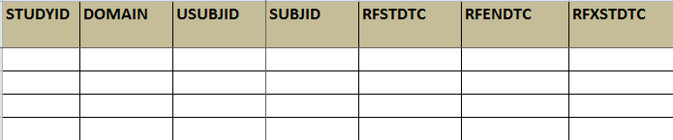
Exercise #2 Getting Started
Open the Mod 4 Exercise Workbook: Mod 4 Ex. 2
All DM variables from the SDTM IG are present at the top of the sheet
Determine which variables in the exercise tab will be needed per the SDTM standard, the Lilly Standard, and the CRF pages
-Grey out those variables that are not needed.
Enter data from the CRF pages into the appropriate variables
Highlight cells where data is required per Lilly, but the CRF does not contain this data
…
Notes:
Review this slide and the next

Slide 42
Exercise #2 Assumptions
Assume the study is still open
Assume all sites are in the USA
Assume all patients were dosed once and all subjects were dosed on 2013-03-15. Use this date as your reference start and end date (RFSTDTC/RFENDTC), as well as for the reference exposure dates (RFXSTDTC/RFXENDTC).
Assume all patients received the dose to which they were randomized.
Create USUBJID per Lilly standards:
STUDYID-SITEID-SUBJID
ARM = DRUG X or DRUG Y. ARMCD = A-X or A-Y
Refer to the Lilly Core DM standard, Business_Algorithm for Lilly AGE algorithm – You do not need to run the calculation.
Notes:
Review assumptions and leave up on the board. For CDAs, progress to the “Getting Started” slide and then come back to this one.
INV data will come from IMPACT data at Lilly
Instructor Note: ARM and ARMCD have now been defined for this exercise in the assumptions (no need to use your imagination). Changed 7.2.15 jle

Slide 43
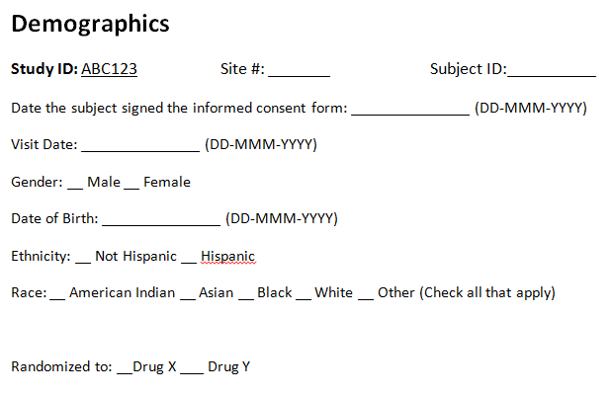
Exercise #2 – DM CRF

Slide 44
Exercise #2 – Add Data
DM Domain – Complete the dataset based on the data provided. Here is a start…
STUDYID | DOMAIN | USUBJID | SUBJID | RFSTDTC | RFENDTC | SITEID | BRTHDTC
ABC123 | DM | ABC123-001-00001 | 00001 | 2013-03-15 | 2013-03-15 | 001 | 1955-01-15
AGE | AGEU | SEX | RACE | ETHNIC | ARMCD | ARM
58 | YEARS | M | WHITE | HISPANIC OR LATINO | A-X | DRUG X
Go Back

Slide 45
Exercise #2 – Controlled Terminology
What is the correct CT for Ethnicity?

Slide 46
Exercise #2 – Things to consider:
Which variables in the SDTMIG will you include?
Which variables in the SDTMIG will you exclude?
How will you handle missing data?
How will you choose the reference day?
How will you handle multiple RACES marked?
Does the CRF use Lilly Controlled Terminology (CT)?
If CT was not used, how will you handle this?
If a value is not in the CT list, how will you handle this?
For the character variables, what length would you choose if you were programming this domain?
Notes:
For CDAs, Review these questions and have the students give answers when the exercise is complete

Slide 47
Example #2 – Possible Answer Part 1
STUDYID | DOMAIN | USUBJID | SUBJID | RFSTDTC | RFENDTC | RFXSTDTC | RFXENDTC
ABC123 | DM | ABC123-001-00001 | 00001 | 2013-03-15 | 2013-03-15 | 2013-03-15 | 2013-03-15
ABC123 | DM | ABC123-001-00002 | 00002 | 2013-03-15 | 2013-03-15 | 2013-03-15 | 2013-03-15
ABC123 | DM | ABC123-002-00003 | 00003 | 2013-03-15 | 2013-03-15 | 2013-03-15 | 2013-03-15
RFICDTC | RFPENDTC | DTHDTC | DTHFL | SITEID | INVID | INVNAM | BRTHDTC | AGE | AGEU
201-02-02 |  |  |  | 001 |  |  | 1955-01-15 | 58 | YEARS
2013-02-04 |  |  |  | 001 |  |  | 1958-03-31 | 54 | YEARS
2013-02-14 |  |  |  | 002 |  |  | 1947-11-27 | 65 | YEARS
Notes:
Reminder: Do not clean the data. Leave missing values….study is open.
Review which variables have CT: Lilly and NCI CT
Which variables did trainee’s drop?
Some variables in IG do not have the same core as Lilly does: INVNAM = Perm in IG, Req at Lilly, RACE = Exp in IG, Req at Lilly

Slide 48
Example #2 – Possible Answer Part 2
SEX | RACE | ETHNIC | ARMCD | ARM | ACTARMCD | ACTARM
M | WHITE | HISPANIC OR LATINO | A-X | DRUG X | A-X | DRUG X
F | MULTIPLE | HISPANIC OR LATINO | A-X | DRUG X | A-X | DRUG X
F |  | NOT HISPANIC OR LATINO | A-Y | DRUG Y | A-Y | DRUG Y
COUNTRY | DMDTC | DMDY
USA | 201-02-06 | -661380
USA | 2013-02-04 | -39
USA | 2013-02-15 | -28

Slide 49
Summary
Special Purpose domains are domains that do not conform to one of the three general observation classes (Interventions, Events, Findings)
CO: Comments
DM: Demographics
SE: Subject Elements
SV: Subject Visits (unlike TV, SV can contain unplanned visits)
Not all SDTM variables are captured on the CRF
Variables with Controlled Terminology need to have the Codelists defined. Resources include:
NCI (CDISC CT)
Lilly Global Library
Lilly Standards / SLDs, Study Specs
SDTM IG

Slide 50
End of Lilly Module 4 ☺

